Slide 1
Assignment 1 proposal
7441 Advanced Game programming

Slide 2
Idea: Game using box2d and sfml/opengl
Create 2 small, yet detailed games using the same base code/engine
Use kinematic objects to make a simple (boring) game more interactive and challenging
Bounce pads, spike traps, elevators, cannons, rope bridges, etc
Allows a basic idea to be very modular and scalable
Create tools/utilities to make level design as easy as possible

Slide 3
Level Designer
Need to save a lot of the box2D object data such as textures, friction, restitution, position, etc. in a simple format that can be parsed into the program to save/load levels
Proposed using XML and a parser such as pugixml to perform this
Helps with scalability and can allow a lot to be done on a simple engine once a general game format is created
Can be used for the following games (next slide); will likely implement Game1 first using the designer, and maybe game2 if there’s time

Slide 4
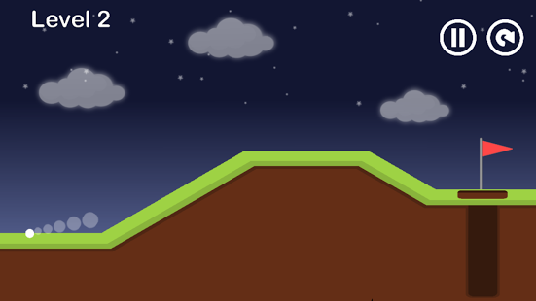
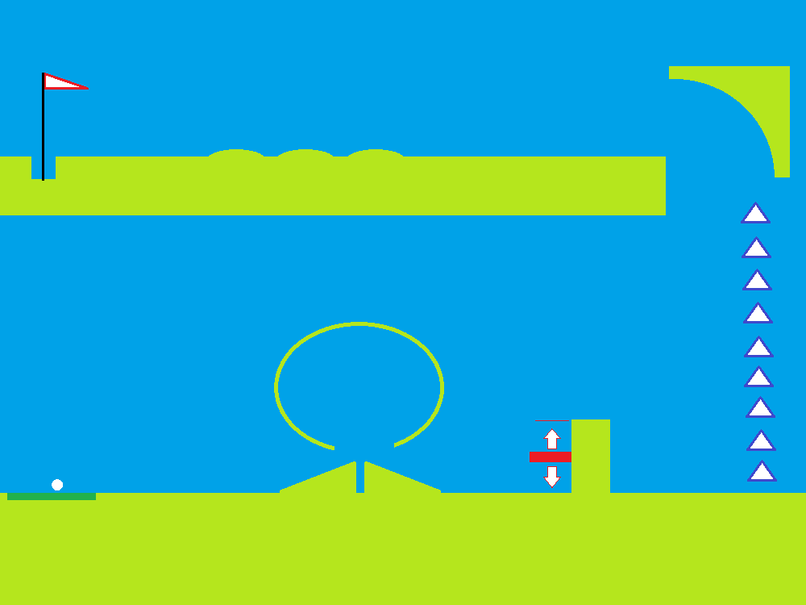
Mini Golf:
2D Platform, side view (side scrolling using view for larger level).
Most player interaction through mouse (click and drag).
A lot of kinematic object world interaction, some position/proximity events

Slide 5
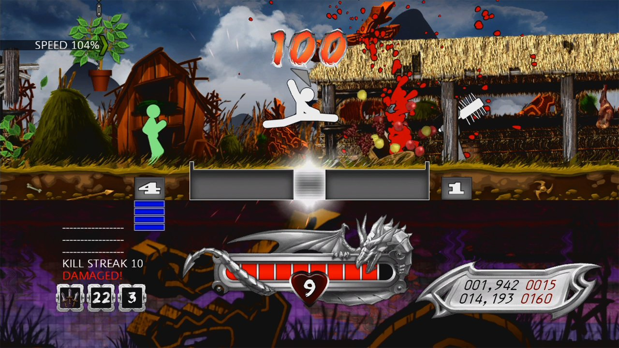
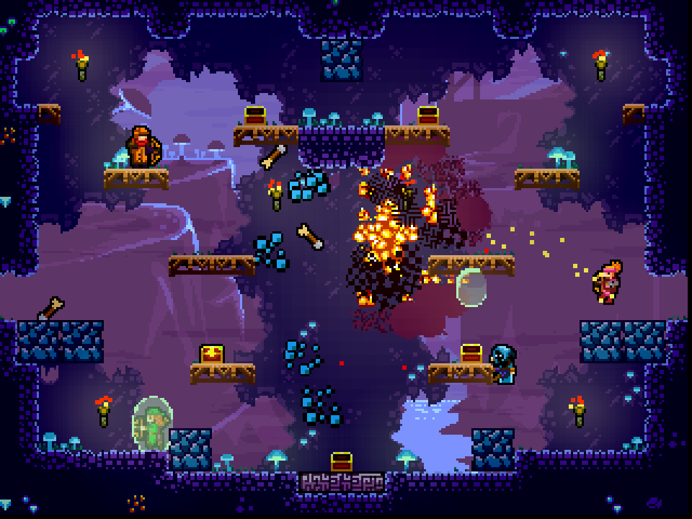
Game 2 Zombie Onslaught
Wave based, last stand, side-on platformer.
One Finger Death Punch / Towerfall Ascension
Gun mechanics using b2 shapes with bullet mode enabled

Slide 6
Risks
Time:
Making the game idea scalable allows for a fully working game to still be achieved in less time.
Creating the tools to develop levels allows for those technologies to be part of the project showcase

Slide 7
Other details:
Timeline: Now – due date.
Capabilities: Experience in SFML from last semester, basic knowledge of AI
More focus on algorithms than the design side of things

Slide 8
Easy vs hard game components
Easy:
Drawing sfml shapes based on box2d body shapes.
Automatic symmetrical shape creation
Physics (thanks, box2d)
Hard:
Creating tools for level design
Saving and loading levels (from file)
AI (other players in mini golf, enemies in zombie wave shooter

Slide 9
Questions / Comments?

